Slide 1


PROJECT TITLE: DIABETIC RETINOPATHY PREDICTION USING XCEPTION (DEEP LEARNING APPROACH)
SRM VALLIAMMAI ENGINEERING COLLEGE
(An Autonomous Institution)
SRM Nagar, Kattankulathur – 603 203
DEPARTMENT OF COMPUTER SCIENCE AND ENGINEERING
1904715 –PROJECT WORK -PHASE 1
SECOND REVIEW
TEAM MEMBERS
SANJAY.H (142221104110)
VIGNESHWAR.S (142221104156)
VISHWA.M (142221104161)
PROJECT GUIDE
Dr.C.PABITHA B.E.,M.E.,Ph.D.
ASSOCIATE PROFESSOR
DEPARTMENT OF CSE

Slide 2
Index
TITLE
ABSTRACT
PROBLEM STATEMENT
OBJECTIVE
LITERATURE SURVEY
EXISTING SYSTEM
PROPOSED SYSTEM
ARCHITECTURE DIAGRAM
MODULES
ALGORITHM USED
SAMPLE CODE
OUTPUT
CONCLUSION
REFERENCES

Slide 3
ABSTRACT
Diabetic retinopathy (DR) is a severe eye condition caused by prolonged high blood sugar levels, leading to damage to the blood vessels in the retina and potentially resulting in vision loss or blindness if untreated. Early detection and treatment of DR are crucial in preventing vision impairment. This project aims to develop a deep learning model (Xception) for the automated detection of diabetic retinopathy from retinal fundus images. By utilizing a dataset of labeled eye images, the model is trained to identify and classify the presence and severity of diabetic retinopathy. The developed model offers a non-invasive, cost-effective, and rapid screening tool that can assist ophthalmologists in the early diagnosis of diabetic retinopathy, thereby facilitating timely treatment and management of the condition. This project demonstrates the potential of deep learning in enhancing diagnostic accuracy and efficiency in ophthalmology.

Slide 4
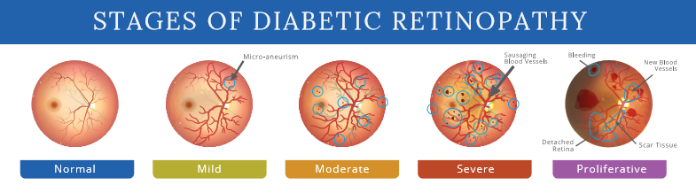
PROBLEM STATEMENT
Diabetic retinopathy (DR) is a leading cause of blindness among adults worldwide, primarily affecting individuals with diabetes.
The condition often progresses without noticeable symptoms until significant damage has occurred, making early detection vital to preventing irreversible vision loss.
This project aims to develop a Deep learning-based model capable of analyzing retinal fundus images to predict the presence and severity of diabetic retinopathy.

Slide 5
OBJECTIVE
The objective of this project is to develop and implement a deep learning-based model for the automated detection and classification of diabetic retinopathy from retinal fundus images.
This model aims to assist in early diagnosis by identifying the presence and severity of diabetic retinopathy, providing a non-invasive, cost-effective, and rapid screening tool.
The goal is to enhance the diagnostic accuracy above 92% and efficiency in ophthalmology, supporting timely treatment and reducing the risk of vision loss in patients with diabetic retinopathy.

Slide 6
LITERATURE REVIEW
S.NO | YEAR | TITLE | AUTHOR | TECHNIQUES USED | DRAWBACKS
1 | 2024 | Diabetic Retinopathy Prediction based on CNN and AlexNet model | Ritesh Chandra, Sadhana Tiwari, Shashi Shekhar Kumar, Sonali Agarwal | CNN & AlexNet, APTOS Dataset, | Limited Generalizability: Models may not perform well on other datasets or in real-world scenarios. Interpretability: Deep learning models are often "black boxes" and lack transparency..

Slide 7
LITERATURE REVIEW
S.NO | YEAR | TITLE | AUTHOR | TECHNIQUES USED | DRAWBACKS
2 | 2023 | Prediction of Diabetic Retinopathy Based on Risk Factors using Machine Learning Algorithms | Nor Tasha Nadira Nor Azamen, Azliza Mohd Ali, Nor Azimah Abd Aziz | Logistic Regression (LR), Support Vector Machine (SVM), and K-Nearest Neighbors (KNN) | Small Dataset: Limited data (361 instances) restricts the model's ability to generalize well to larger populations. Model Performance: SVM had relatively low accuracy (70.27%) and recall, showing the model's struggle with complex, non-linear relationships.

Slide 8
LITERATURE REVIEW
S.NO | YEAR | TITLE | AUTHOR | TECHNIQUES USED | DRAWBACKS
3 | 2023 | Classification of Diabetic Retinopathy Using Image Pre-processing Techniques | Kavya Duvvuri, Harshitha Kanisettypalli, Masabattula Teja Nikhil, Suja Palaniswamy | single-layer Convolutional Neural Network (CNN) ,Grad-CAM (Gradient-weighted Class Activation Mapping), Erosion, Histogram Equalization | Without preprocessing, the model had lower accuracy. The single-layer CNN may not be as effective as more complex models for larger datasets.

Slide 9
LITERATURE REVIEW
S.NO | YEAR | TITLE | AUTHOR | TECHNIQUES USED | DRAWBACKS
4 | 2023 | Detection and Classification of Diabetic Retinopathy using Pretrained Deep Neural Networks | Abini M.A , S. Sridevi Sathya Priya | APTOS 2019 dataset from Kaggle, VGG-16, MobileNetV2 | Early DR stages (like Mild DR) are harder to detect accurately, especially in VGG-16, as shown by its confusion matrix. Variability in image quality (e.g., noise, out-of-focus areas) from different camera models affected classification performance

Slide 10
LITERATURE REVIEW
S.NO | YEAR | TITLE | AUTHOR | TECHNIQUES USED | DRAWBACKS
5 | 2022 | Detection of Diabetic Retinopathy with Retinal Images using CNN | Samiya Majid Baba,Indu Bala | Convolutional Neural Network (CNN) | Limited dataset size (only 757 images for training), which might not generalize well to larger datasets. Overfitting risk: Despite the high accuracy, the model might have overfitted to the small dataset, affecting its performance on unseen data

Slide 11
EXISTING SYSTEM
The existing system for diabetic retinopathy detection predominantly relies on manual examination by trained ophthalmologists, who analyze retinal fundus images to diagnose the condition.
Additionally, the manual process is susceptible to human error, which can lead to inconsistent results.
Recent developments have focused on automating the detection of diabetic retinopathy using deep learning techniques with accuracy over 92%.
These existing models can extract features from retinal images, significantly improving diagnostic accuracy and consistency using CNN.

Slide 12
EXISTING SYSTEM (CONTINUATION):
Traditional Machine Learning Systems Approach: Early systems for diabetic retinopathy detection typically used traditional machine learning techniques such as Support Vector Machines (SVMs), k-nearest neighbors (KNN), and decision trees. These methods often relied on handcrafted features extracted from retinal images, such as blood vessel detection, exudate detection, or texture analysis.
Drawbacks:
Feature Engineering: Handcrafted features can be insufficient for capturing complex patterns in retinal images.
Low Accuracy: These systems tend to have lower accuracy compared to deep learning methods due to the reliance on predefined feature extraction methods.
Limited Scalability: Not ideal for handling large, diverse datasets and new data without significant re-engineering.

Slide 13
EXISTING SYSTEM (CONTINUATION):
Convolutional Neural Networks (CNNs) Approach: CNN-based systems became widely adopted for diabetic retinopathy detection, where CNNs automatically learn to extract features from images without manual feature engineering. ResNet, InceptionNet, and VGG are commonly used architectures.These systems are usually applied for classification (e.g., determining the severity of DR from images).
Drawbacks:
High Data Requirements: CNNs require a large amount of labeled data for training, which can be a challenge for medical datasets where annotations are expensive to obtain.
Black Box Nature: Limited interpretability, which is a critical concern in medical domains where understanding the "why" behind decisions is important.

Slide 14
PROPOSED SYSTEM
The proposed system aims to use a Xception model a deep learning technique to automatically detect diabetic retinopathy from retinal fundus images.
The system will be trained using a labeled dataset of eye images, allowing it to learn and identify features that indicate the presence and severity of diabetic retinopathy.
Preprocessing steps, such as image resizing, normalization, will be applied to improve image quality and model performance.
Here, we use Xception, which is more efficient due to its transfer learning making it faster and more effective for classification than other methods.
This approach offers a fast, non-invasive, and cost-effective tool for detecting diabetic retinopathy, especially in resource-limited settings.

Slide 15
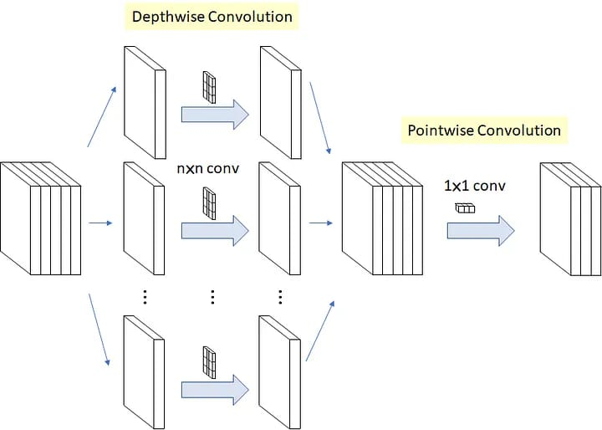
ARCHITECTURE DIAGRAM
Initial Input
Output Feature Map

Slide 16
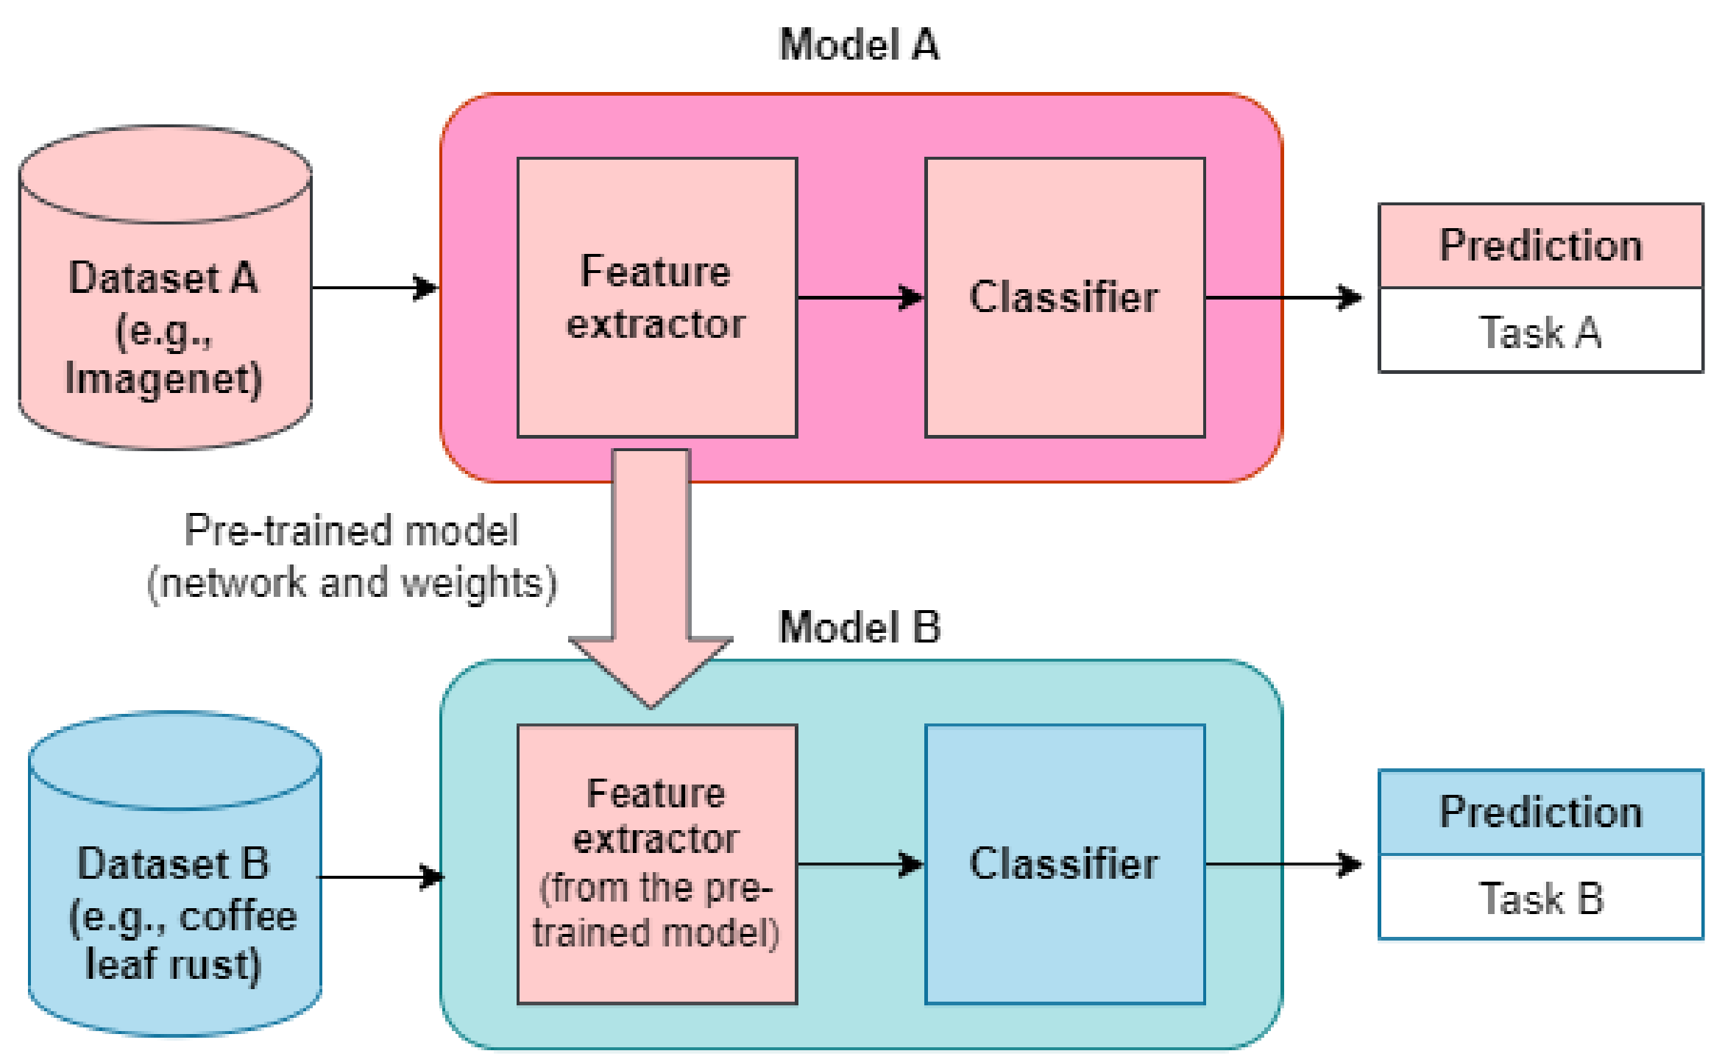
ARCHITECTURE DIAGRAM

Slide 17
MODULES
Data Acquisition Description:
Collect the dataset of retinal fundus images. Common datasets include APTOS, which contain labeled images indicating the severity of diabetic retinopathy.
Outcome: A well-annotated dataset with images classified into categories like no DR, mild, moderate, severe, and proliferative DR.
Data Preprocessing Description:
Resize (299 x 299 pixels) and normalize images (0 – 1) for uniformity. Perform noise reduction and contrast enhancement to improve image quality. Apply data augmentation techniques (e.g., rotation, flipping) to increase the variability of the training data.
Outcome: A clean and balanced dataset ready for input into the model.

Slide 18
MODULES
Data Annotation and Labeling Description:
Labeling Strategy: Since Xception is primarily used for classification, label each retinal image with its corresponding diabetic retinopathy severity category.
Outcome: An annotated dataset with labels corresponding to diabetic retinopathy stages and optional lesion annotations if applicable.
Model Selection and Architecture (Xception) Description:
Utilize the Xception Model: Use the pre-trained Xception model as a backbone for image classification. The model consists of depthwise separable convolutions, which help in efficient feature extraction.
Output Layer Modification: Modify the final dense layer to classify the images into the appropriate categories for diabetic retinopathy.
Outcome: A well-defined architecture ready for training on the retinal dataset

Slide 19
MODULES
Model Training Description:
Split the Dataset: Divide the dataset into training, validation, and test sets (e.g., 70% training, 15% validation, 15% test).
Train the Xception Model: Train the model on the training set using metrics such as categorical cross-entropy loss for classification.
Hyperparameter Optimization: Optimize hyperparameters such as learning rate, batch size, and the number of epochs based on validation performance.
Outcome: A trained model capable of classifying retinal images into diabetic retinopathy severity categories with high accuracy

Slide 20
MODULES
Model Evaluation Description:
Evaluate the Model: Use performance metrics such as accuracy, precision, recall, F1-score, and confusion matrix to assess the classification performance for different stages of diabetic retinopathy.
Cross-validation: Optionally perform k-fold cross-validation to ensure the robustness of model evaluation.
Outcome: A detailed evaluation of model accuracy and classification capability.

Slide 21
ALGORITHM USED
Overview:
Xception (Extreme Inception) is a deep learning model based on depthwise separable convolutions, designed for efficient image processing. When applied to diabetic retinopathy (DR) prediction, Xception classifies retinal fundus images according to DR severity levels: no DR, mild, moderate, severe, and proliferative DR.
Advantages:
Efficiency: The depthwise separable convolutions reduce the number of parameters, leading to faster training and inference times.
High Accuracy: Xception’s architecture is designed for better feature extraction, making it capable of achieving higher accuracy on complex image classification tasks like diabetic retinopathy.
Transfer Learning: By leveraging a pre-trained model, the system can benefit from previously learned features, requiring less training data and time.

Slide 22
XCEPTION ARCHITECTURE OVERVIEW
Input Image : The input to the model is a retinal fundus image, which is preprocessed to enhance visibility of the retinal features (blood vessels, lesions, etc.).
Initial Convolutional Backbone : Convolutional Layer: 32 filters, 3×33×3 kernel, stride of 2, with ReLU activation. Convolutional Layer: 64 filters, 3×33×3 kernel, stride of 1, with ReLU activation. This block helps to extract low-level features from the input image

Slide 23
Depthwise Separable Convolutions: The core of the Xception architecture consists of multiple depthwise separable convolution blocks. Each block is made up of two main components: Depthwise Convolution: Applies a single convolutional filter to each input channel (3 channels in RGB images). It processes spatial dimensions independently for each channel. Pointwise Convolution: A 1×11×1 convolution that combines the outputs of the depthwise convolution across channels, allowing for feature mixing. Each depthwise separable convolution block in Xception includes: 1) Batch Normalization 2)ReLU Activation

Slide 24
4. Stack of Depthwise Separable Convolution Blocks:
The original Xception architecture consists of 14 of these blocks, organized in three main sections: > Entry Flow: The first few blocks that capture high-level features. > Middle Flow: Contains several (usually 8) depthwise separable convolution blocks to deepen the feature extraction process. > Exit Flow: Reduces dimensionality and prepares features for final classification.
5. Skip Connections: Xception employs skip connections (similar to residual connections) in the entry and exit flows to facilitate gradient flow and improve training.

Slide 25
6. Global Average Pooling Layer: After the final convolution block, a global average pooling layer is used to reduce the spatial dimensions to a single vector per channel. 7. Fully Connected Layer: The output of the global average pooling layer is passed to one or more dense layers for final classification.
The final layer typically employs a softmax activation function for multi-class classification tasks.

Slide 26
SAMPLE CODING
import os
import numpy as np
from sklearn.preprocessing import LabelEncoder
from tensorflow.keras.preprocessing.image import ImageDataGenerator
from tensorflow.keras.applications import Xception
from tensorflow.keras.layers import Dense, GlobalAveragePooling2D
from tensorflow.keras.models import Model
from tensorflow.keras.optimizers import Adam
from tensorflow.keras.callbacks import ModelCheckpoint, EarlyStopping
train_dir = 'data' # Your training data directory
class_names = sorted(os.listdir(train_dir)) # Get class names from folder names
label_encoder = LabelEncoder()
label_encoder.fit(class_names)
num_classes = len(class_names)

Slide 27
SAMPLE CODING
train_datagen = ImageDataGenerator(
rescale=1.0/255,
rotation_range=20,
width_shift_range=0.2,
height_shift_range=0.2,
shear_range=0.2,
zoom_range=0.2,
horizontal_flip=True,
fill_mode='nearest'
)
train_generator = train_datagen.flow_from_directory(
train_dir,
target_size=(299, 299), # Resize for Xception input
batch_size=32,
class_mode='categorical'
)

Slide 28
SAMPLE CODING
def build_xception_model():
base_model = Xception(weights='imagenet', include_top=False, input_shape=(299, 299, 3))
x = base_model.output
x = GlobalAveragePooling2D()(x)
x = Dense(1024, activation='relu')(x)
predictions = Dense(num_classes, activation='softmax')(x)
model = Model(inputs=base_model.input, outputs=predictions)
return model
def build_xception_model():
base_model = Xception(weights='imagenet', include_top=False, input_shape=(299, 299, 3))
x = base_model.output
x = GlobalAveragePooling2D()(x)
x = Dense(1024, activation='relu')(x)
predictions = Dense(num_classes, activation='softmax')(x)
model = Model(inputs=base_model.input, outputs=predictions)
return model

Slide 29
SAMPLE CODING
def compile_and_train(model, model_name):
model.compile(optimizer=Adam(learning_rate=1e-4), loss='categorical_crossentropy', metrics=['accuracy'])
# Define Callbacks
checkpoint = ModelCheckpoint(f'{model_name}_best_model.keras', monitor='val_accuracy', save_best_only=True, mode='max')
early_stopping = EarlyStopping(monitor='val_loss', patience=5, restore_best_weights=True)
# Train the model
model.fit(
train_generator,
epochs=20,
callbacks=[checkpoint, early_stopping]
)
xception_model = build_xception_model()
print("Training Xception Model...")
compile_and_train(xception_model, 'xception')

Slide 30
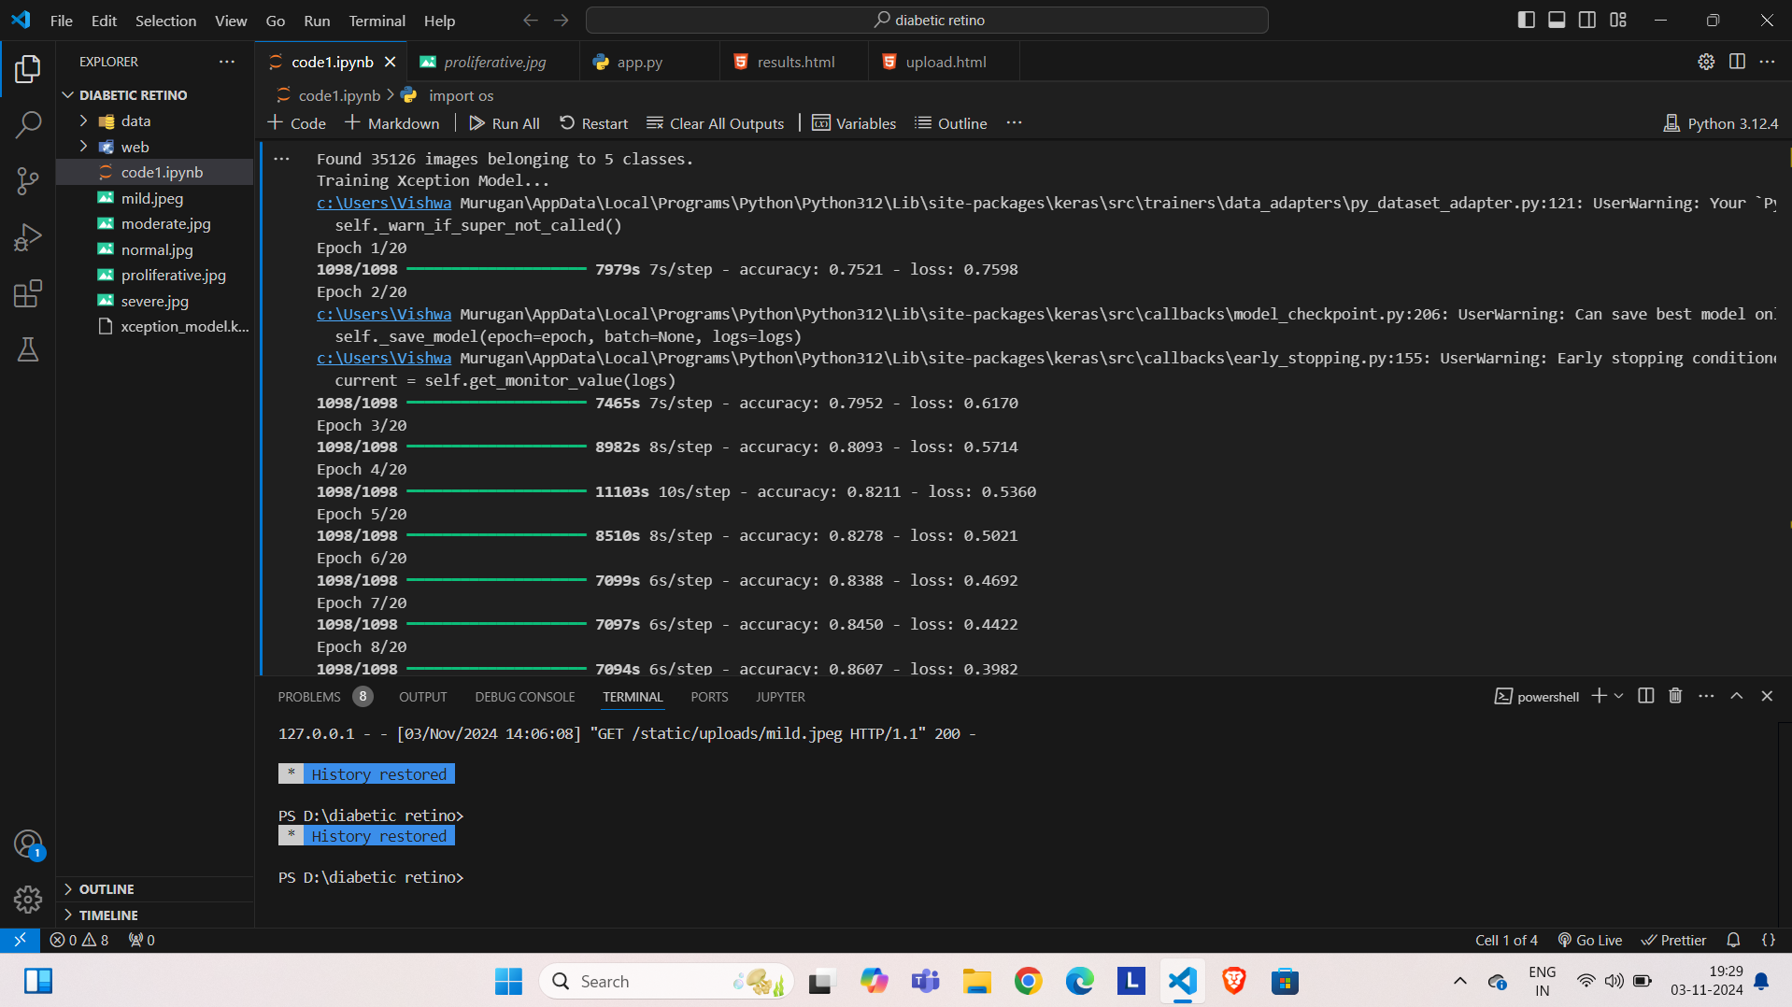
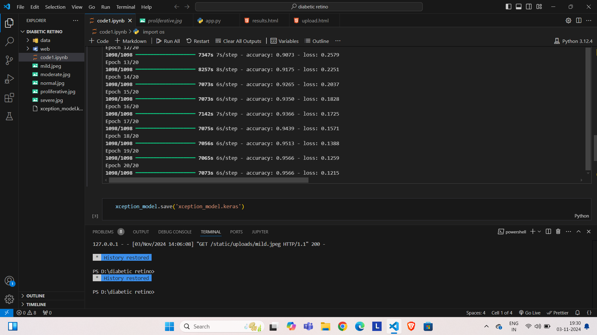
OUTPUT
Training Model of 20 epoch
95.66% accuracy of final epoch

Slide 31
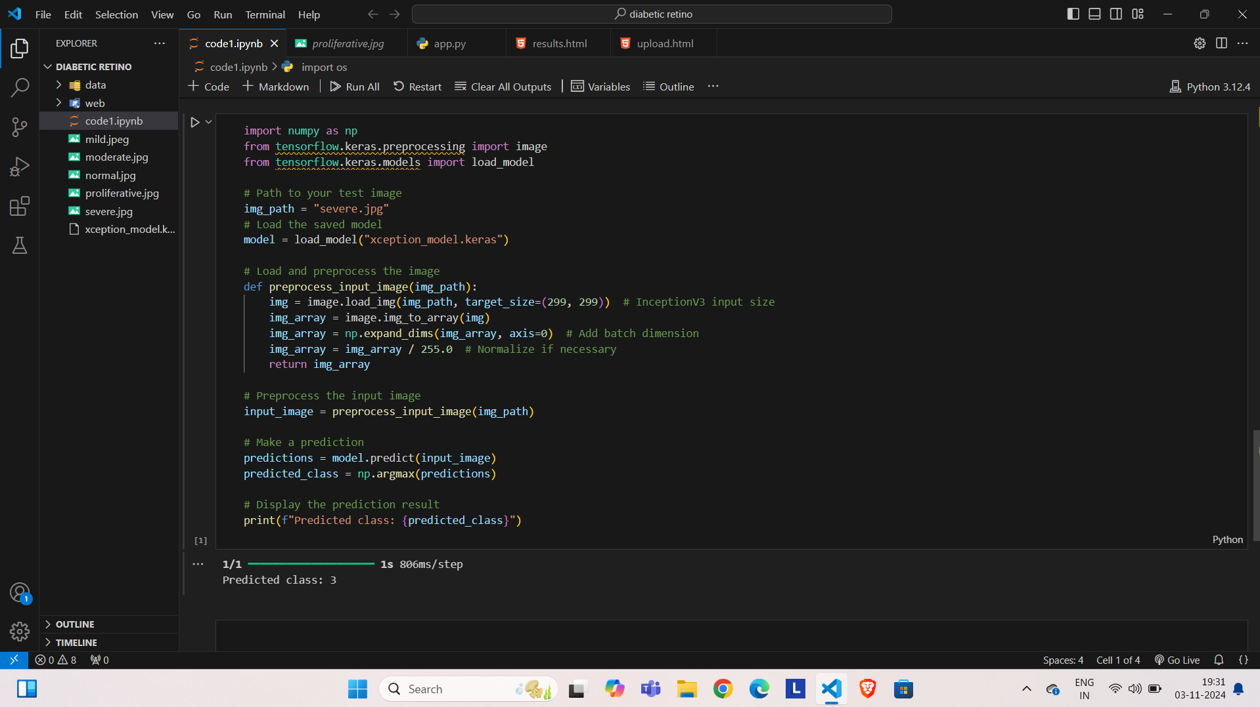
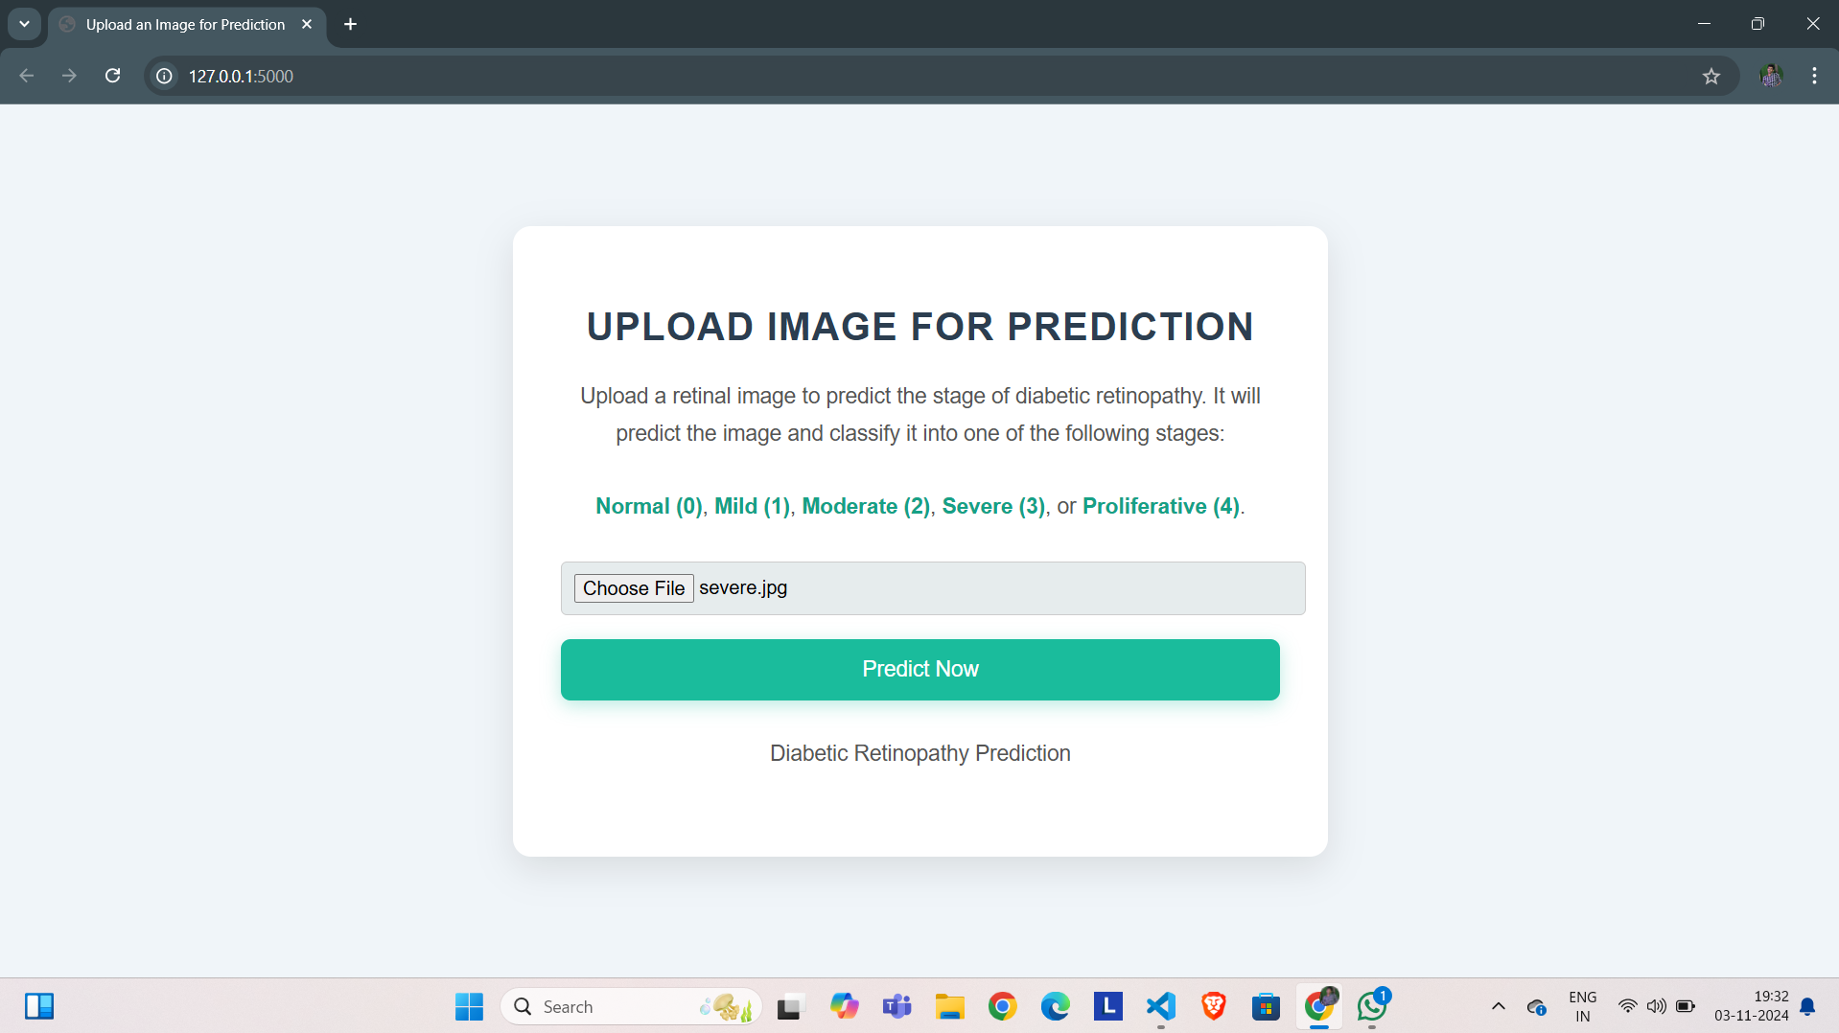
OUTPUT
Direct Output
Web Output

Slide 32
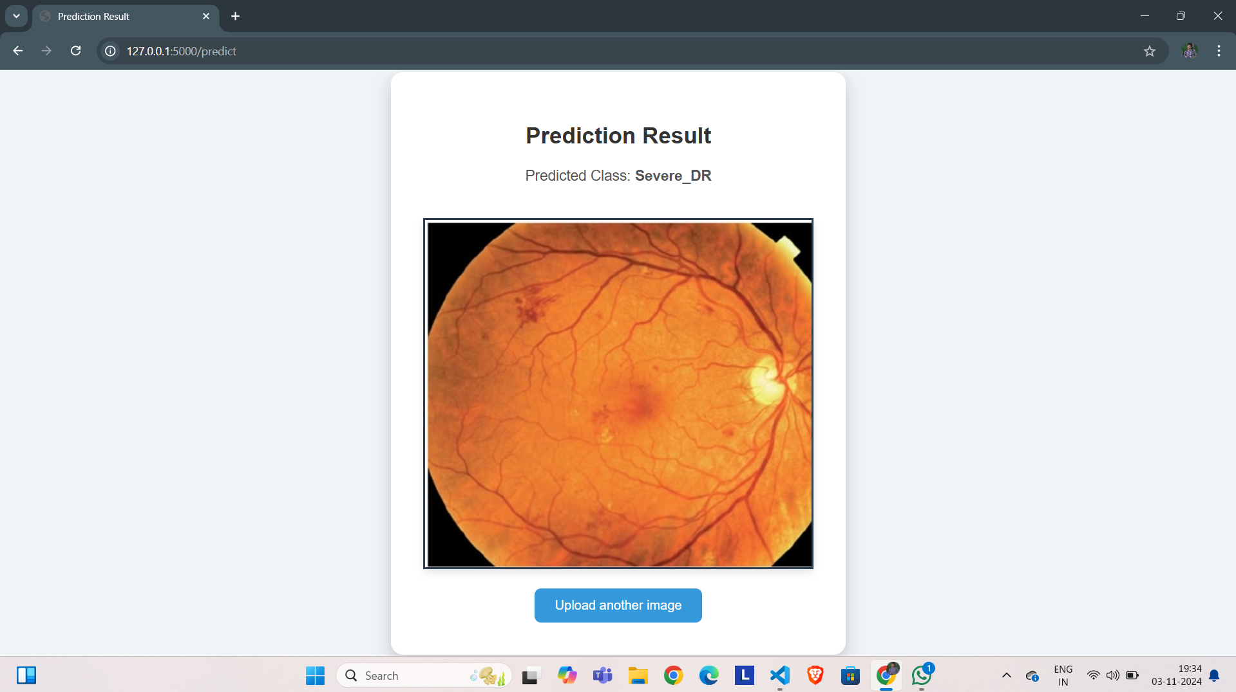
OUTPUT
Web Output

Slide 33
CONCLUSION
In this project, we developed a diabetic retinopathy prediction model using the Xception deep learning architecture, achieving an impressive accuracy of 95.66%. Xception’s depthwise separable convolutions enabled efficient, high-quality feature extraction from retinal fundus images with low computational costs. This high accuracy indicates the model’s effectiveness in identifying and classifying diabetic retinopathy stages, from no DR to proliferative DR, highlighting its potential as a valuable tool for early detection and diagnosis. By using transfer learning on a pre-trained Xception model, we accelerated training and improved performance, even with limited labeled data.

Slide 34
REFERENCES
1.Prediction of Diabetic Retinopathy Based on Risk Factors using Machine Learning Algorithms/2023 4th International Conference on Artificial Intelligence and Data Sciences (AIDAS)/DOI: 10.1109/AIDAS60501.2023.10284646
2. Diabetic Retinopathy Prediction based on CNN and Alex Net model/2024 14th InternationalConferenceonCloudComputing,DataScience&amp;Engineering(confluence)/DOI:10.1109/CONFLUENCE60223.2024.10463351
3. Detection of Diabetic Retinopathy with Retinal Images using CNN/Sixth International Conference on Intelligent Computing and Control Systems (ICICCS 2022)/DOI:10.1109/ICICCS53718.2022.9788368

Slide 35
REFERENCES
4.Detection and Classification of Diabetic Retinopathy using Pretrained Deep Neural Networks/2023 International Conference on Innovation in EngineeringandTechnology(ICIET)/DOI:10.1109/ICIET57285.2023.10220715
5. Classification of Diabetic Retinopathy Using Image Pre-processing Techniques/2023 3rd International Conférence on Intelligent Technologies (CONIT) /DOI:10.1 109/CONIT59222.2023.10205586

